Slide 1















DATA 400 Project Presentation
Presented by Munkhtsatsral & Margaret

Slide 2

Predicting College Diversity Scores
Our project aims to predict the diversity score of universities based on the ethnic and international composition of students and faculty, as well as correlations with factors like college ranking and endowment.
The analysis covers both National Universities and Liberal Arts Colleges.
We examine data from the 2012-2013 to 2021-2022 academic years to determine factors influencing diversity.
Main goal: Predict university diversity score based on various factors, primarily focusing on ethnicity and international status of students and faculty.

Slide 3
System of interrelated surveys conducted annually by the U.S Department of Education's National Center for Education Statistics
Source Overview
It gathers data from every college and university participating in federal student financial aid programs, with data collection occurring in the fall, winter, and spring.
IPEDS: Integrated Postsecondary Education Data System
U.S. News Ranking
U.S. News ranks nearly 1,500 U.S. four-year bachelor’s degree-granting institutions, organized within 10 distinct categories where colleges and universities are compared with others that share similar academic missions.

Slide 4
The national-university data frame contains data for 192 distinct national universities with 48 variables (columns) and has a size of (125,359, 48). The large number of rows is due to the repetition of major data across multiple years for each university.
Data Overview
The liberal-arts-college data frame contains data on 203 distinct liberal arts colleges across 38 states and spans 9 academic years. With 48 variables and approximately 78,413 rows, the dataset includes repeat observations across multiple years.
Some of the variables include university name/college name, state, academic year, student diversity, graduation rates, and professor demographics.

Slide 5
Two machine-learning models are built: one for National Universities and one for Liberal Arts Colleges.
MethodologyOverview
Dependent Variable: University diversity score (based on student and faculty demographics).
Data Sources: We used the IPEDS Completion Data and the U.S. News & World Report Historical Rankings to gather essential variables such as race/ethnicity breakdowns, student-to-faculty ratio, and college rankings.
Independent Variables: Key features include student major composition, gender distribution, professor salaries, financial aid availability, and college ranking.

Slide 6
Universities: Gain insights into diversity’s impact on rankings and endowments, guiding diversity policies and recruitment
Implications for Stakeholders
Students: Increased awareness of diversity metrics that may affect educational experiences and institutional choices
Faculty and staff: Potential for improved hiring practices to ensure representation and inclusivity
Government and educational policy makers: Data can support policies encouraging diversity in higher education

Slide 7
Ethical:
- Ensuring responsible data use to avoid misinterpretation or reinforcing biases
- Protecting individual privacy in dataset creation and analysis
Ethical, Legal, and Societal Considerations
- Legal:
- Complying with data privacy laws (e.g., FERPA) in handling student and faculty information
- Avoiding discriminatory practices in model recommendations
- Societal:
- Addressing potential societal expectations for diversity in higher education
- Encouraging transparency in diversity metrics and models for broader community trust

Slide 8
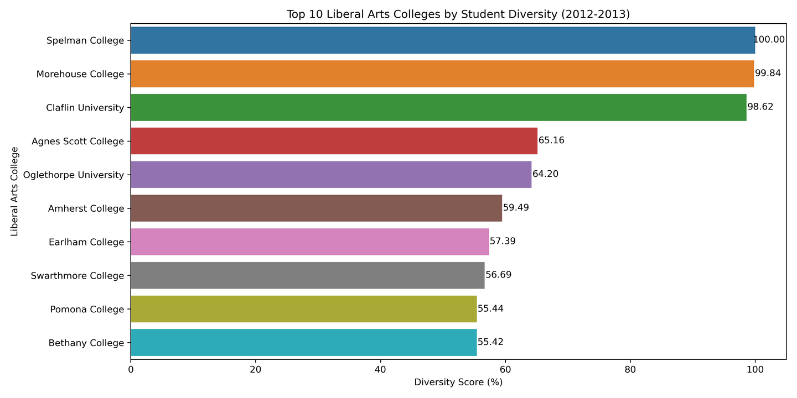
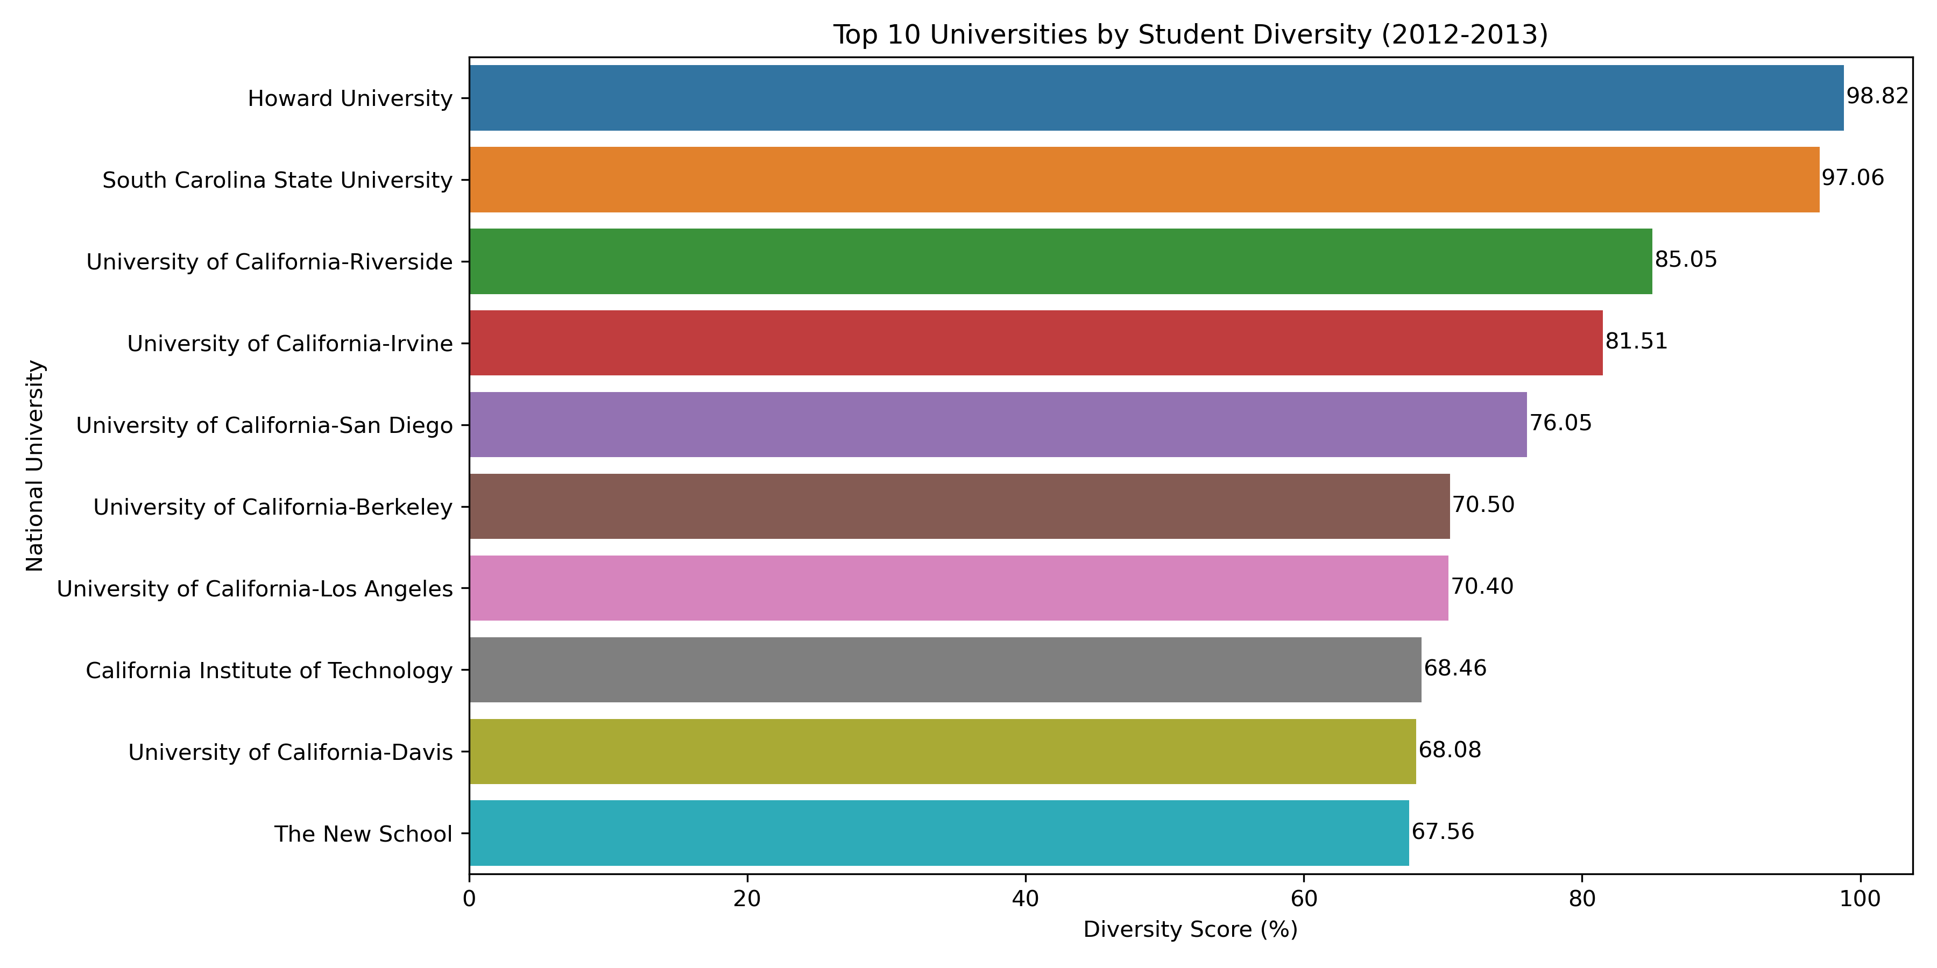
Descriptive Statistics and Data Exploration
Student Diversity (2012-2013): Top 10 Liberal Arts Colleges VS National University

Slide 9
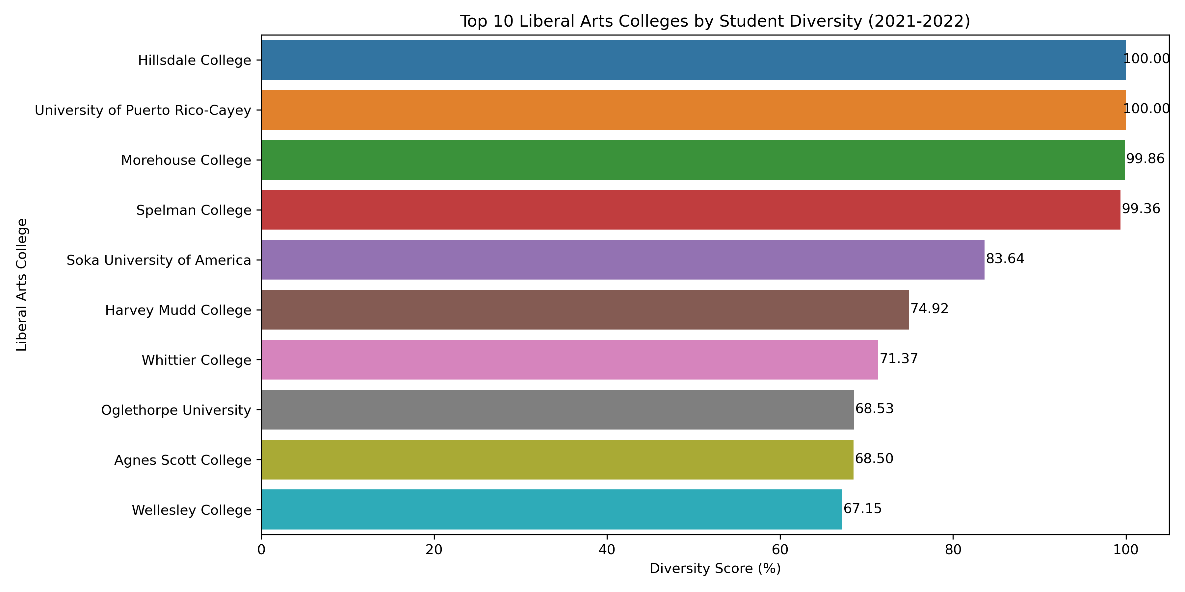
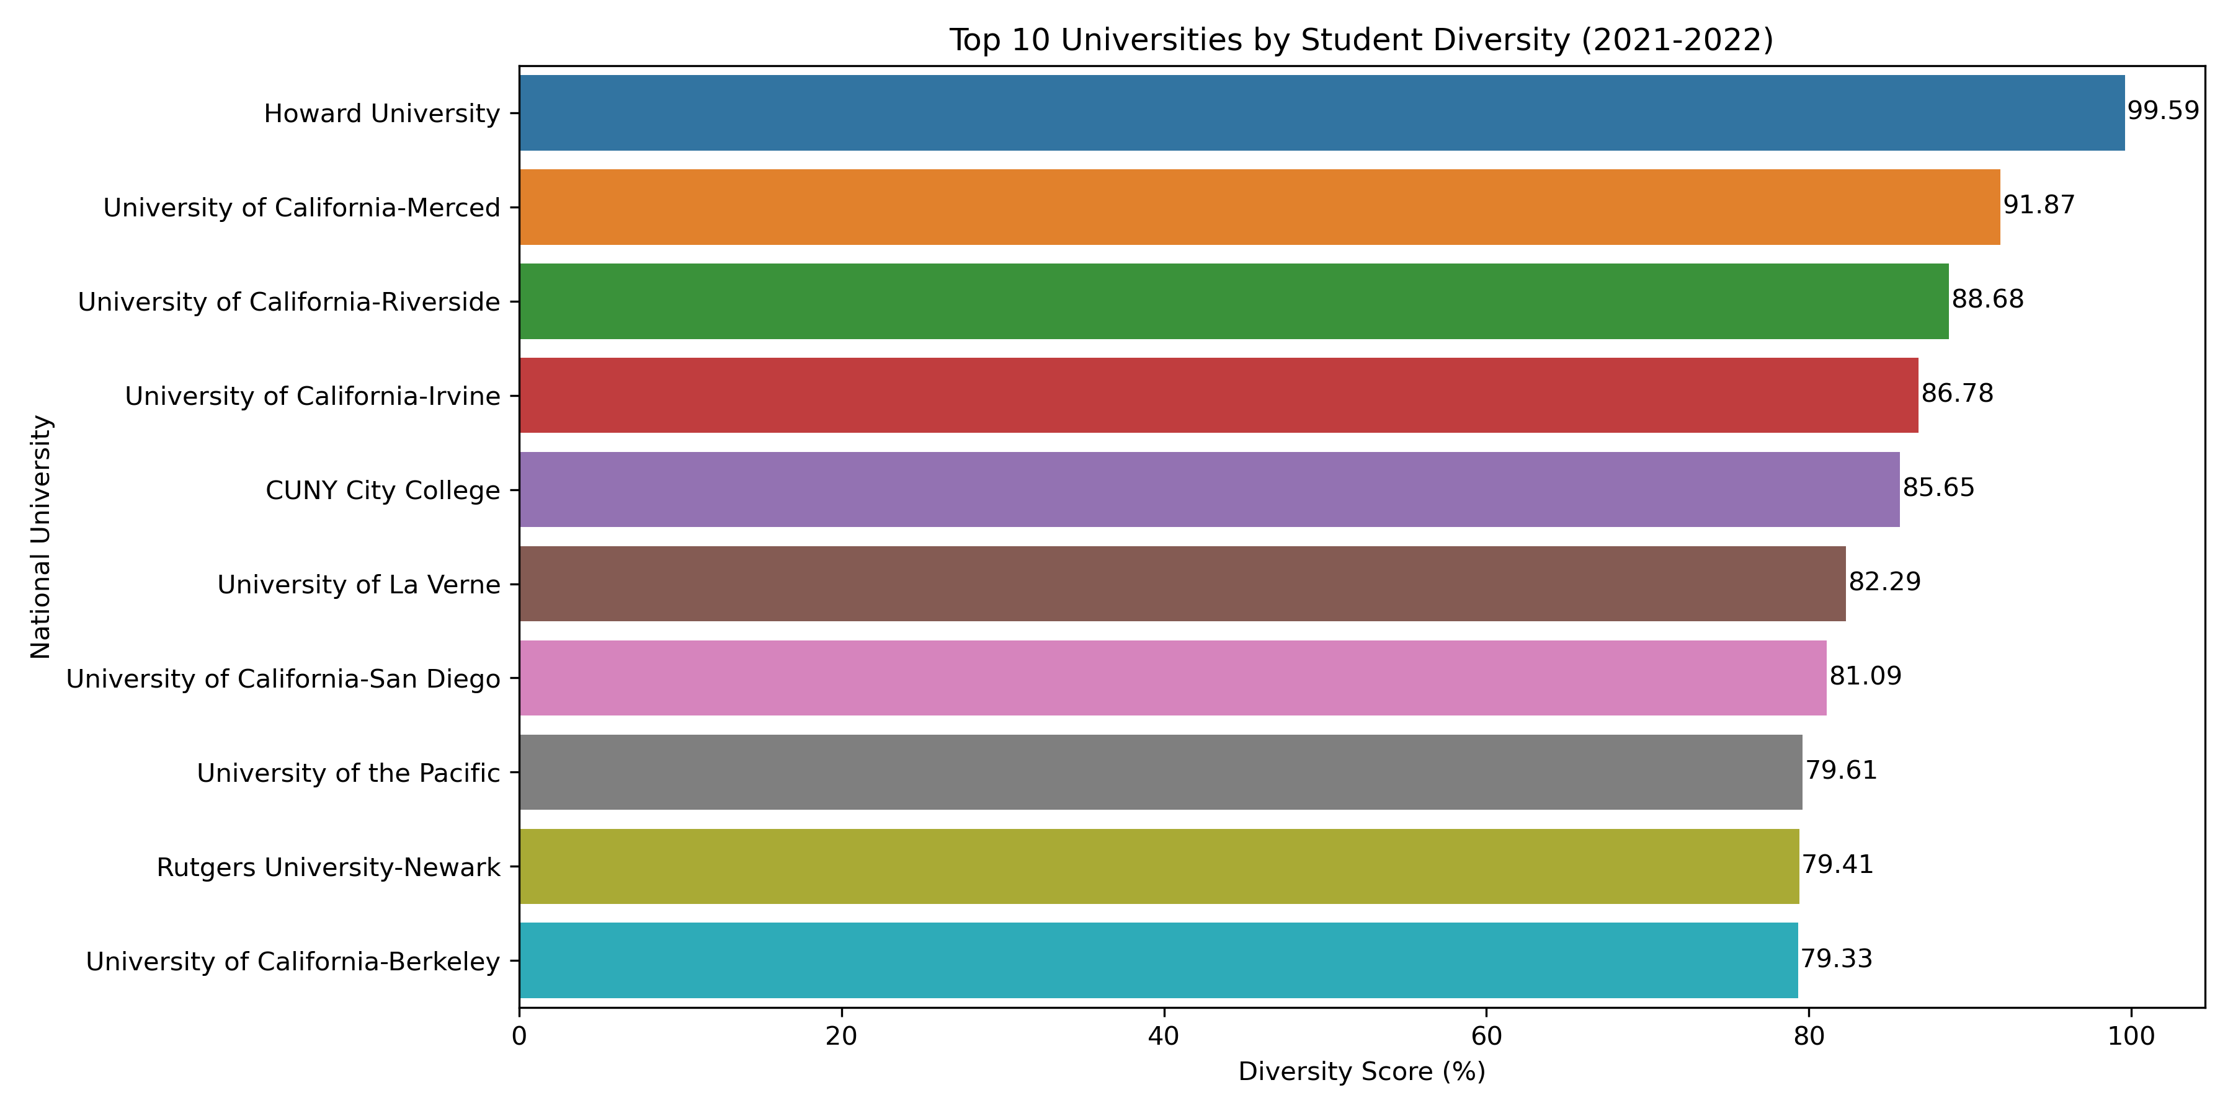
Descriptive Statistics and Data Exploration
Student Diversity (2021-2022): Top 10 Liberal Arts Colleges VS National University

Slide 10
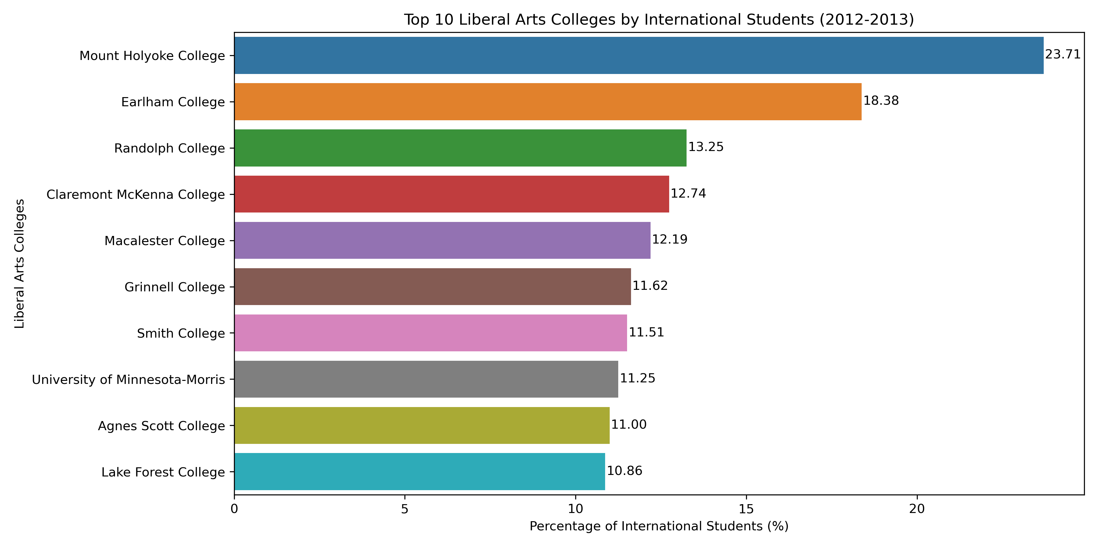
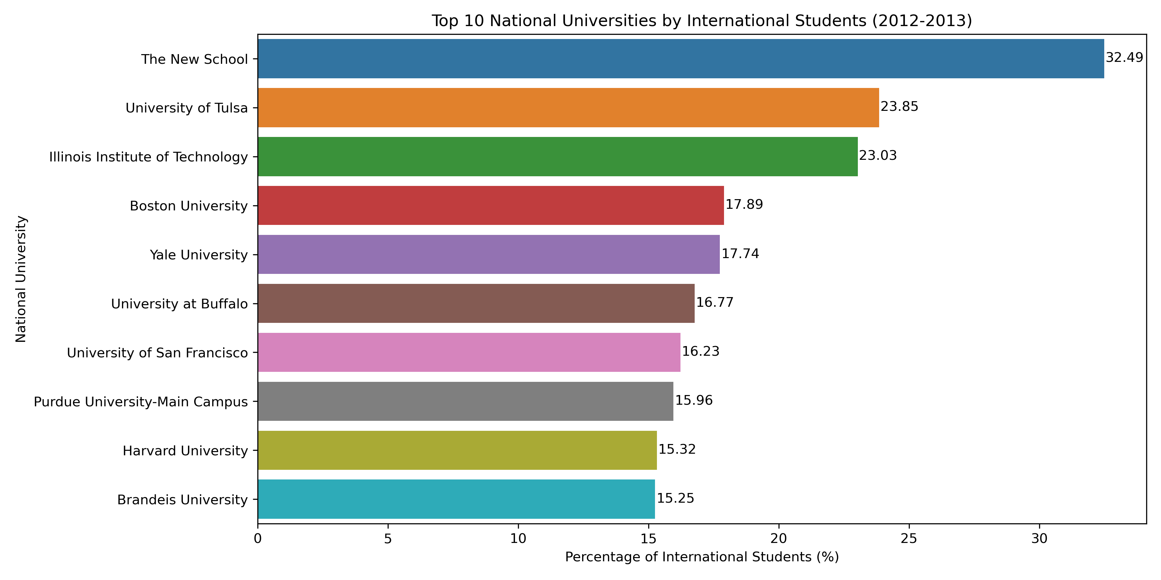
Descriptive Statistics and Data Exploration
International Student Diversity (2012-2013): Top 10 Liberal Arts Colleges VS National University

Slide 11
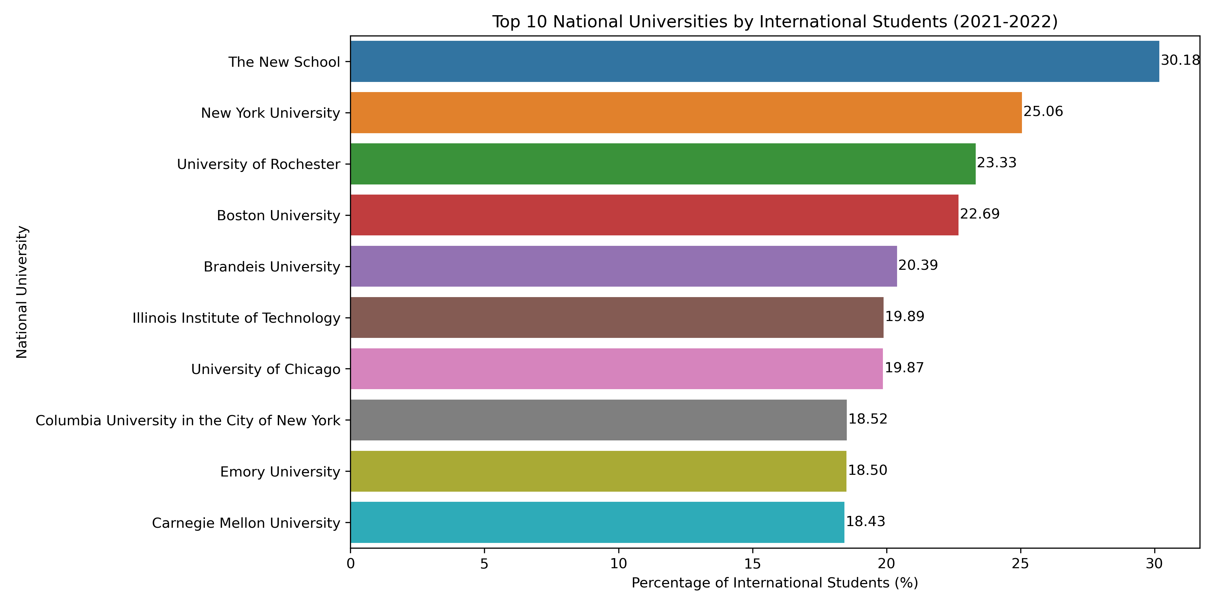
Descriptive Statistics and Data Exploration
International Student Diversity (2021-2022): Top 10 Liberal Arts Colleges VS National University

Slide 12
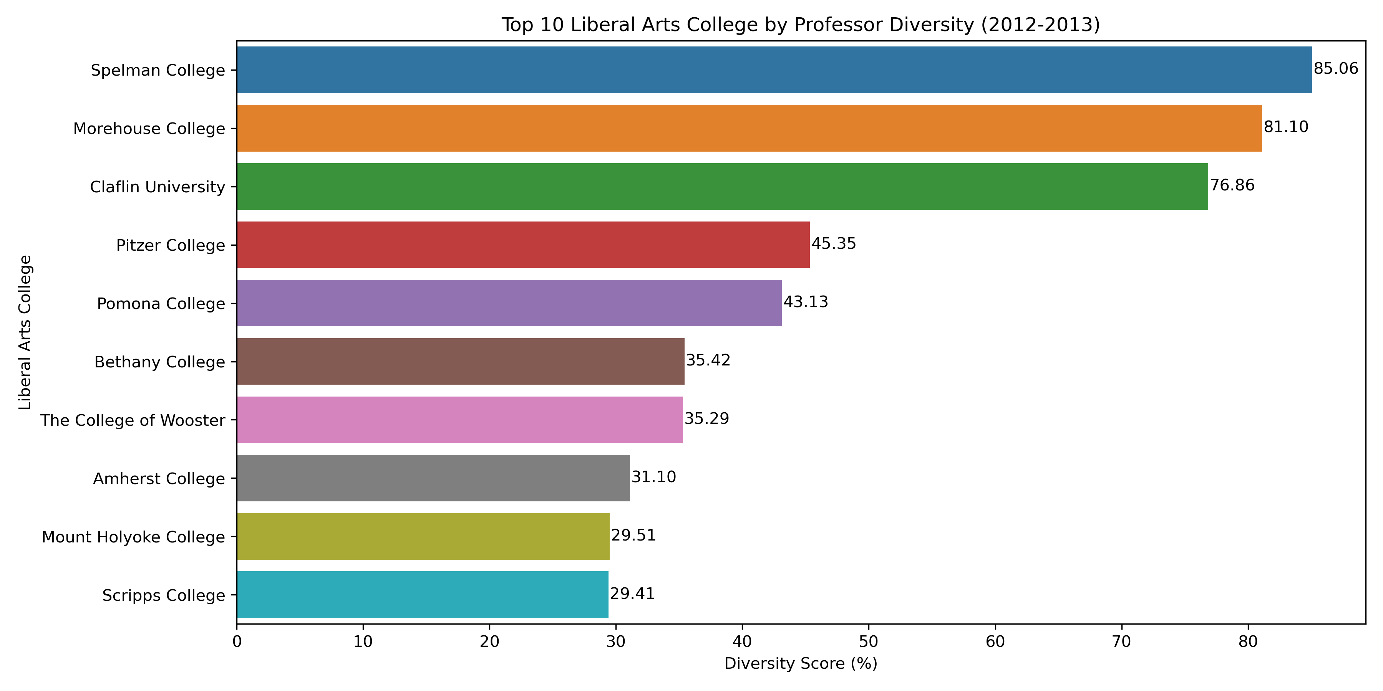
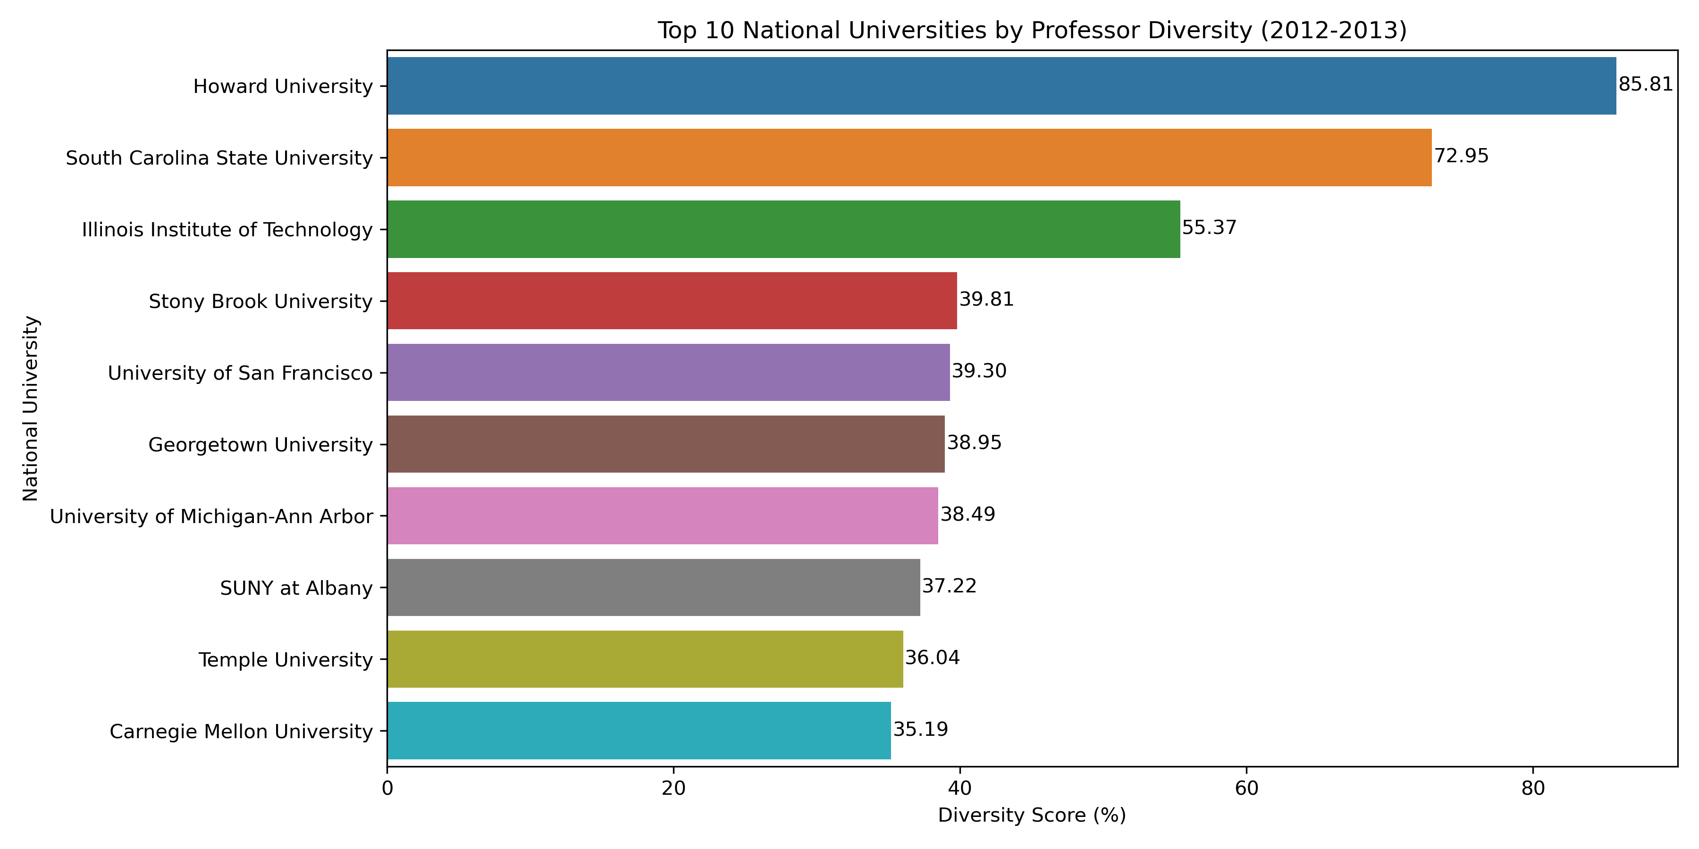
Descriptive Statistics and Data Exploration
Professor Diversity (2012-2013): Top 10 Liberal Arts Colleges VS National University

Slide 13
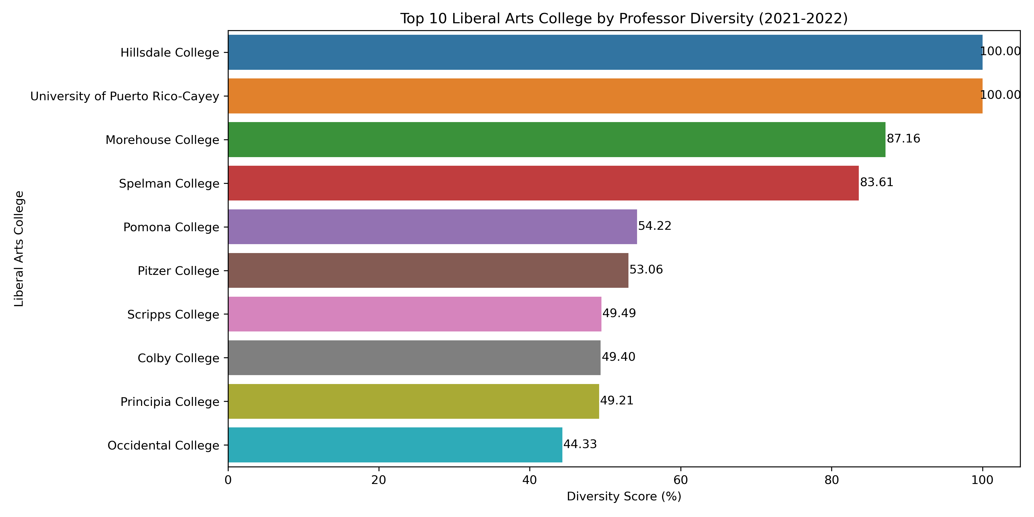
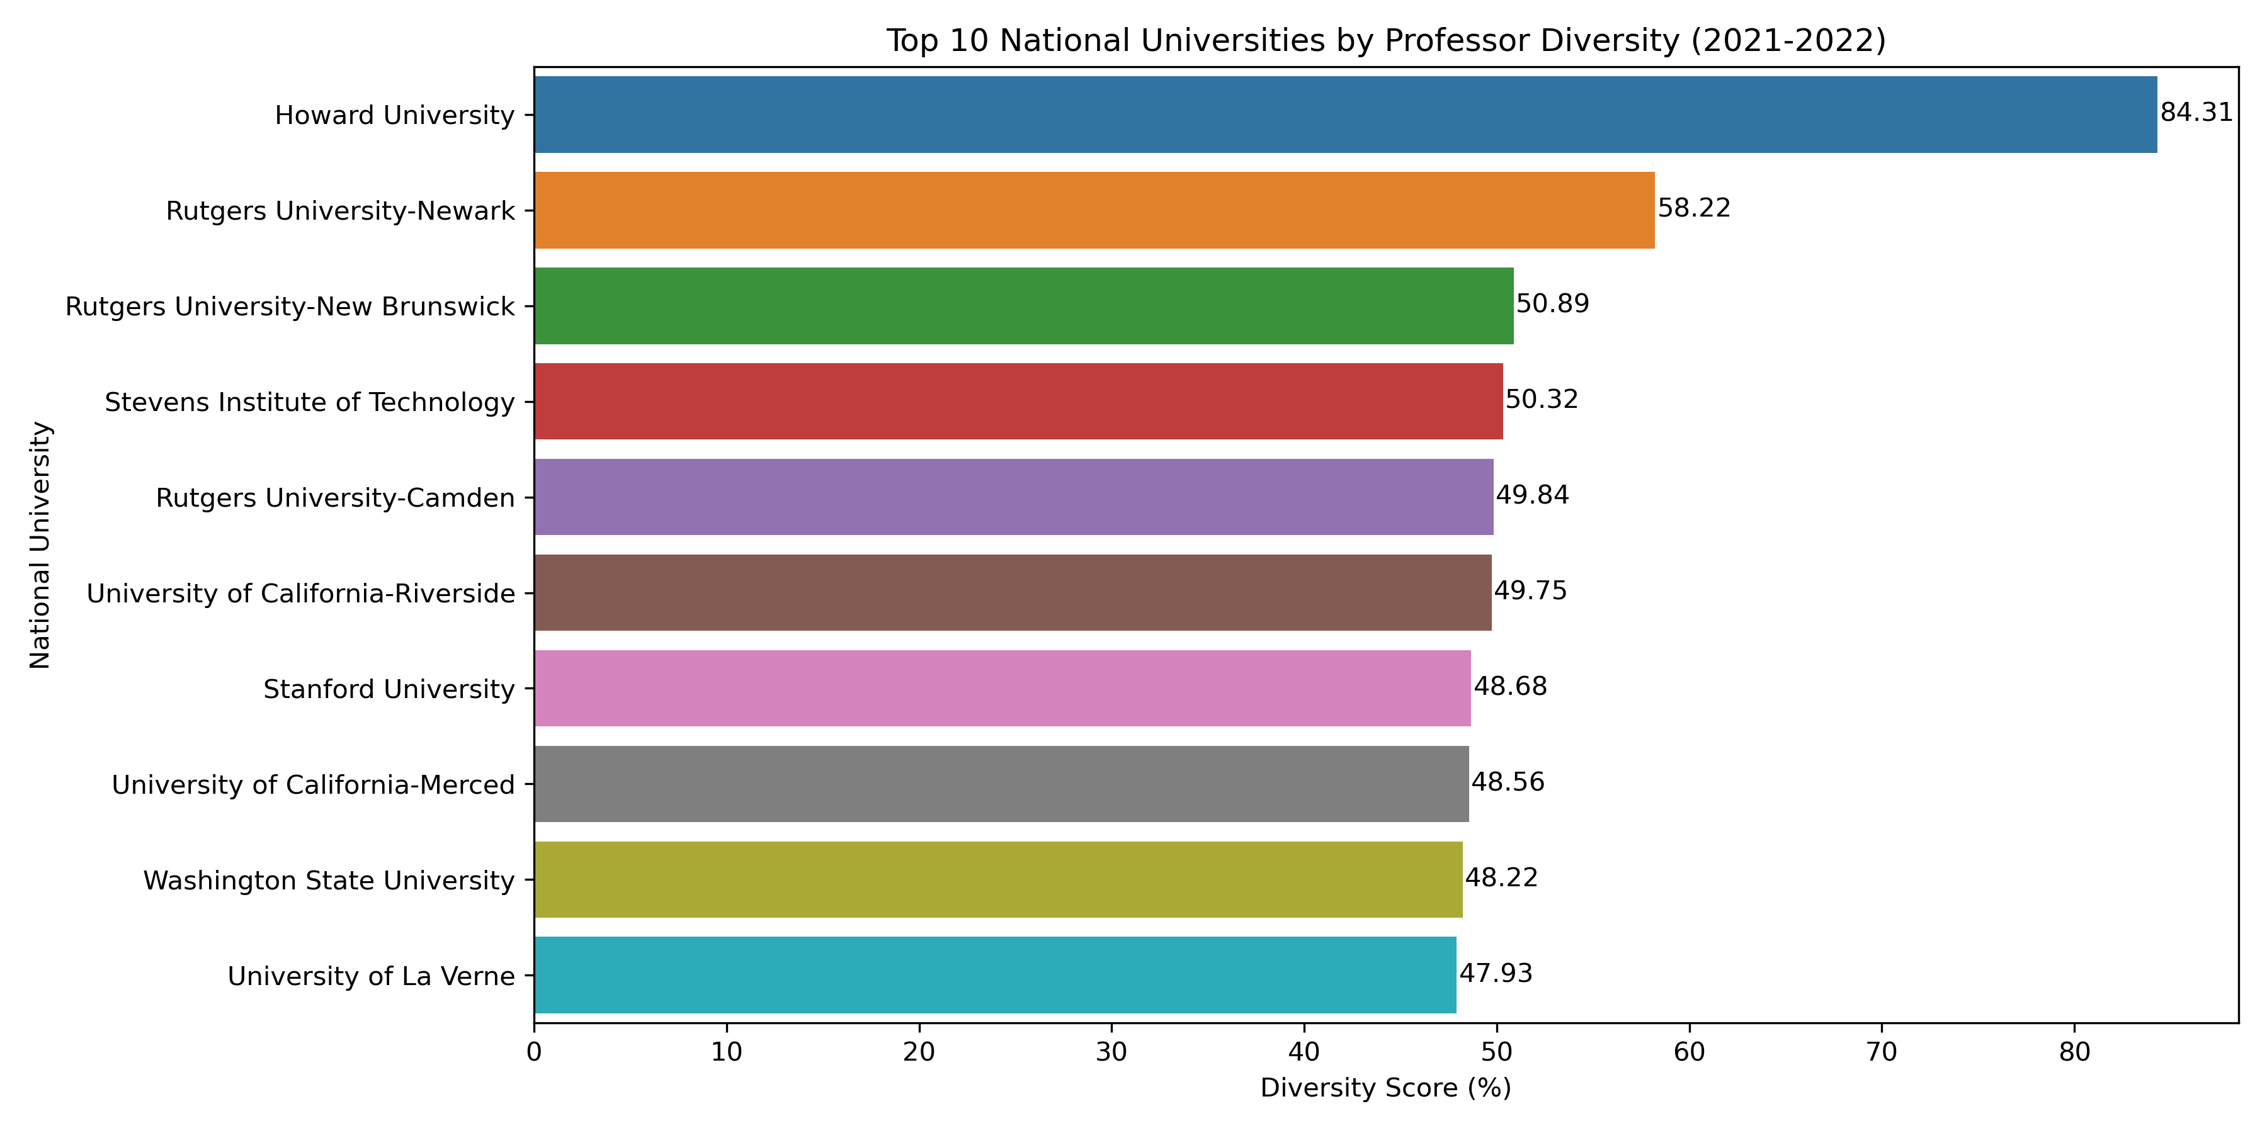
Descriptive Statistics and Data Exploration
Professor Diversity (2021-2022): Top 10 Liberal Arts Colleges VS National University

Slide 14
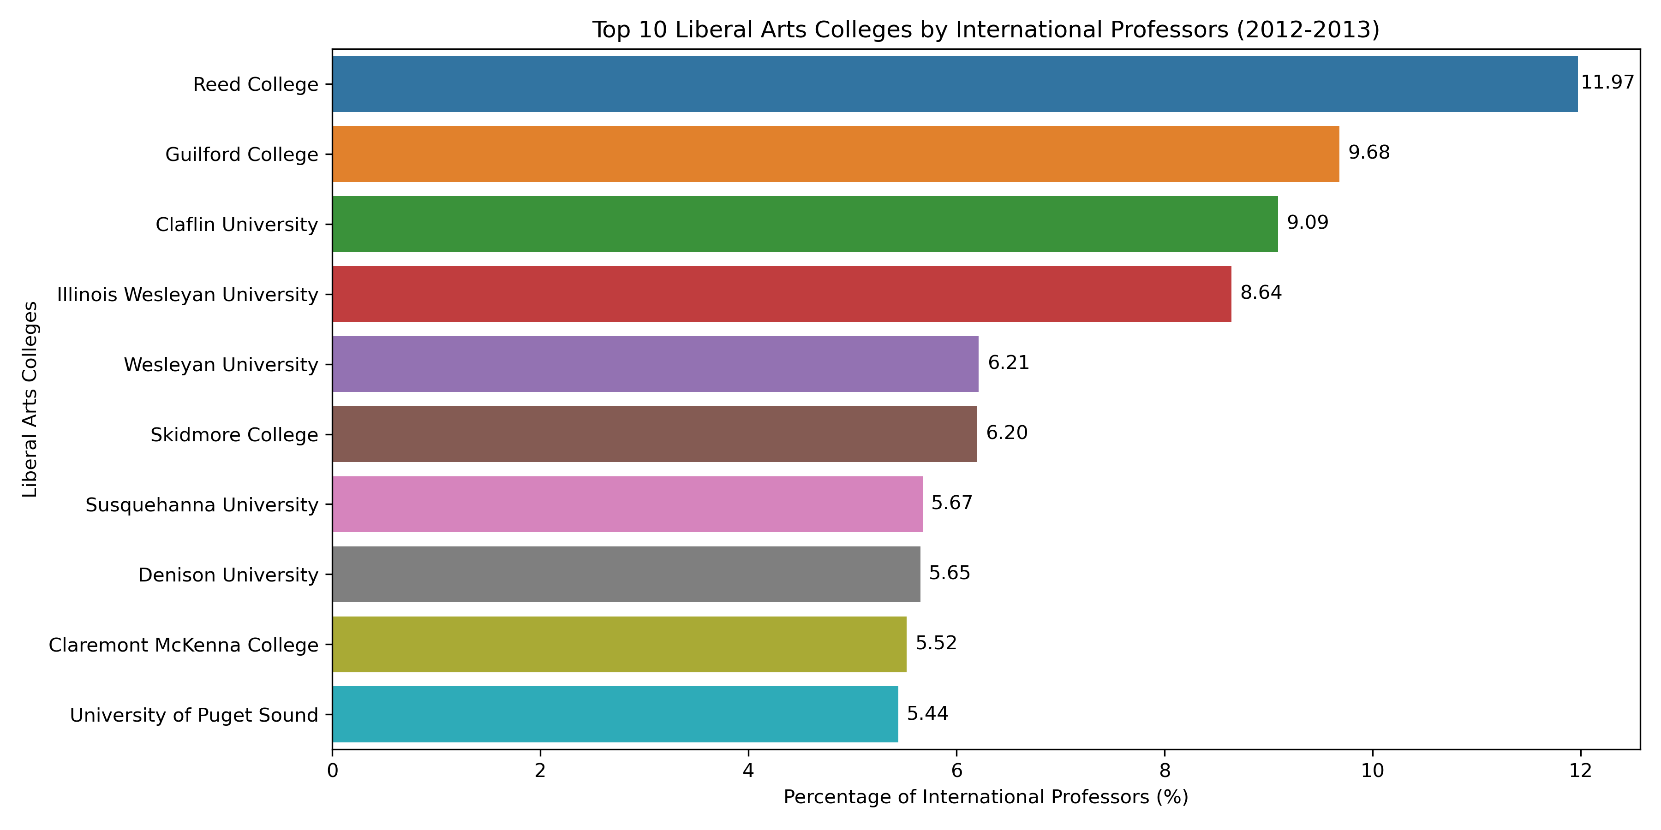
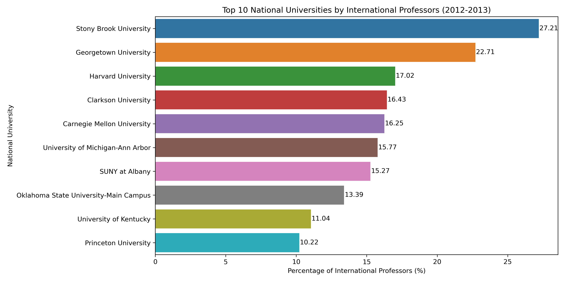
Descriptive Statistics and Data Exploration
International Professor Diversity (2012-2013): Top 10 Liberal Arts Colleges VS National University

Slide 15
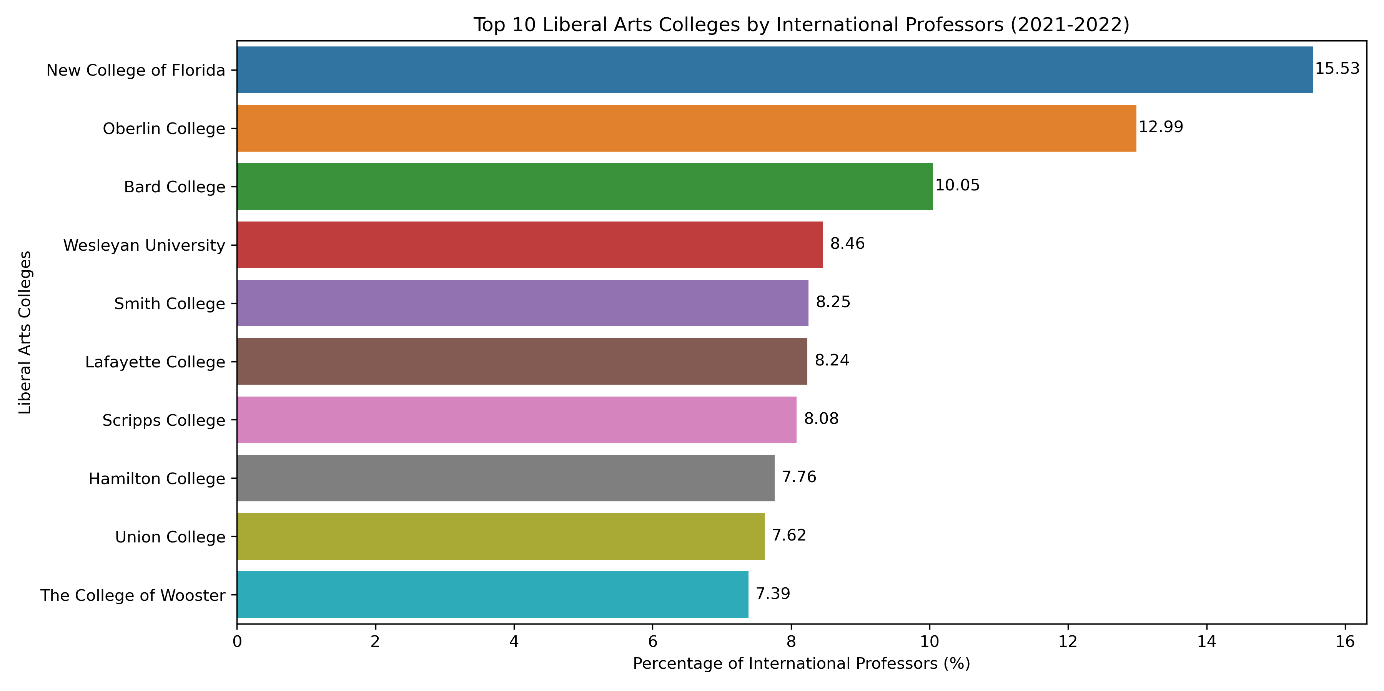
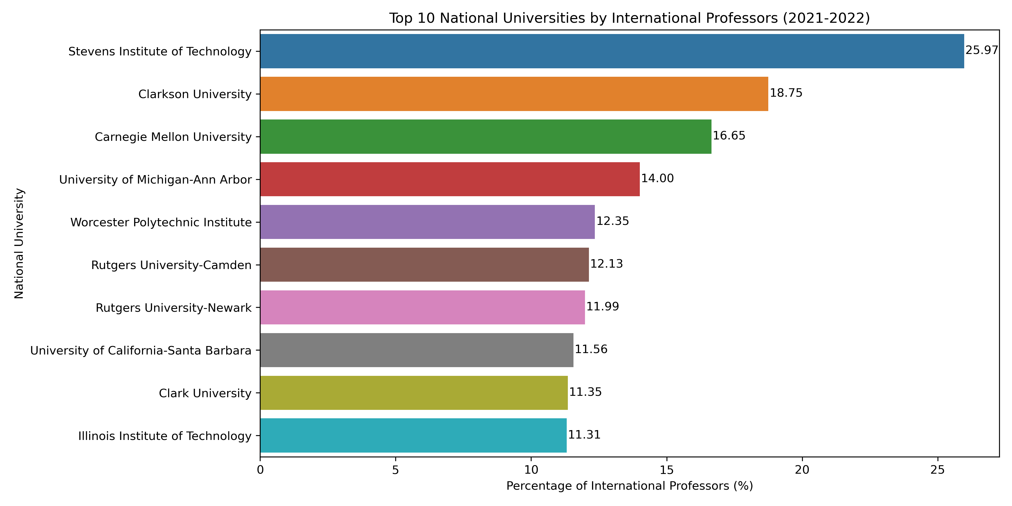
Descriptive Statistics and Data Exploration
International Professor Diversity (2021-2022): Top 10 Liberal Arts Colleges VS National University

Slide 16
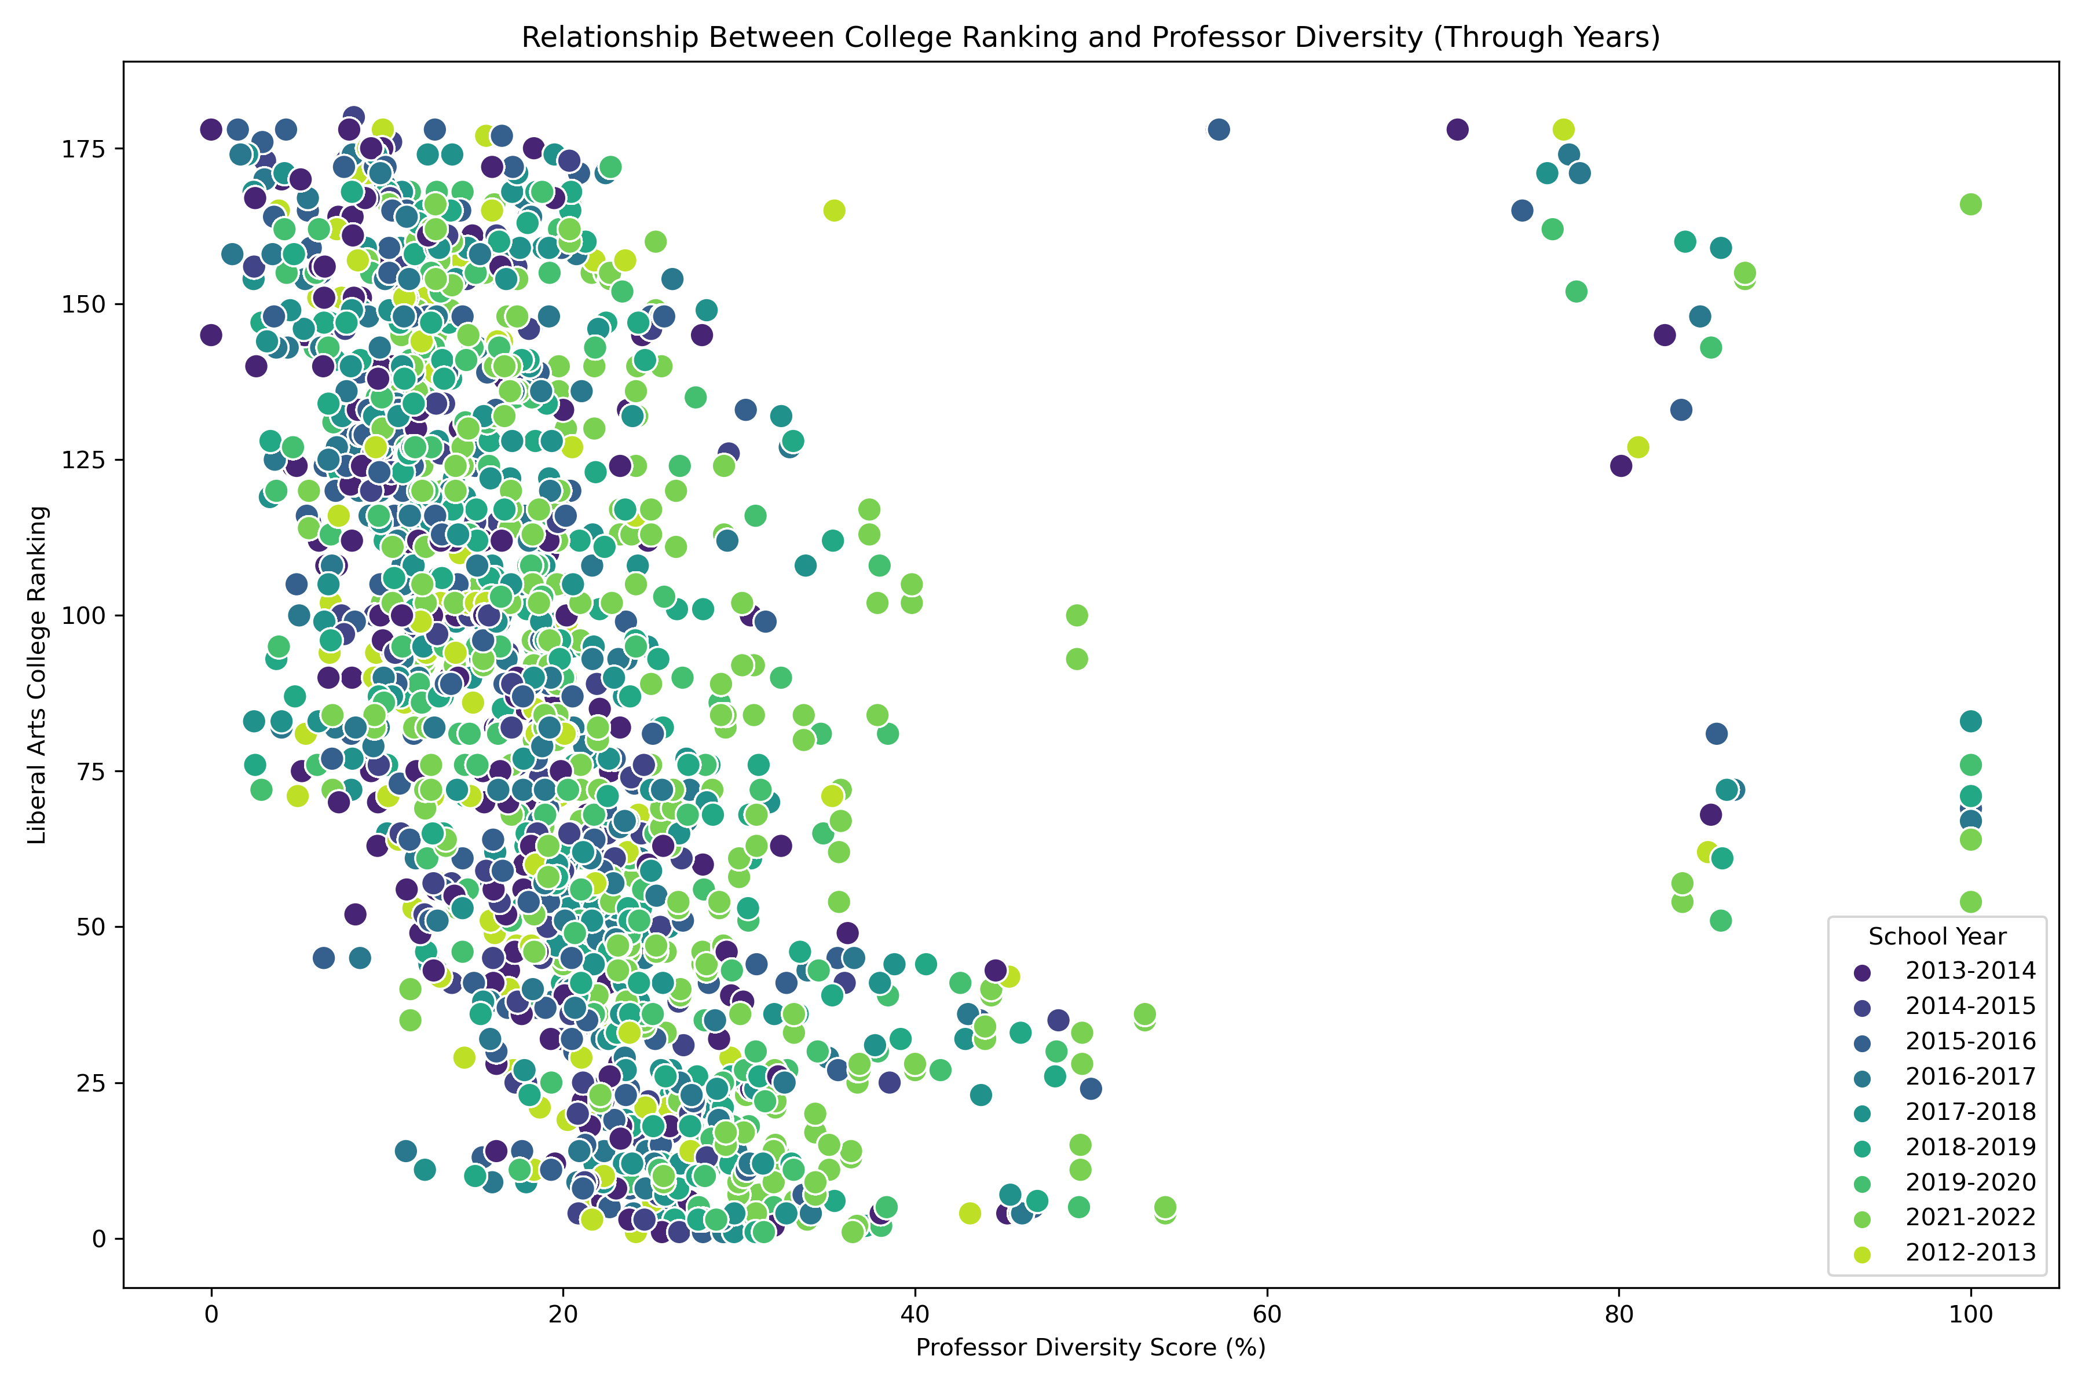
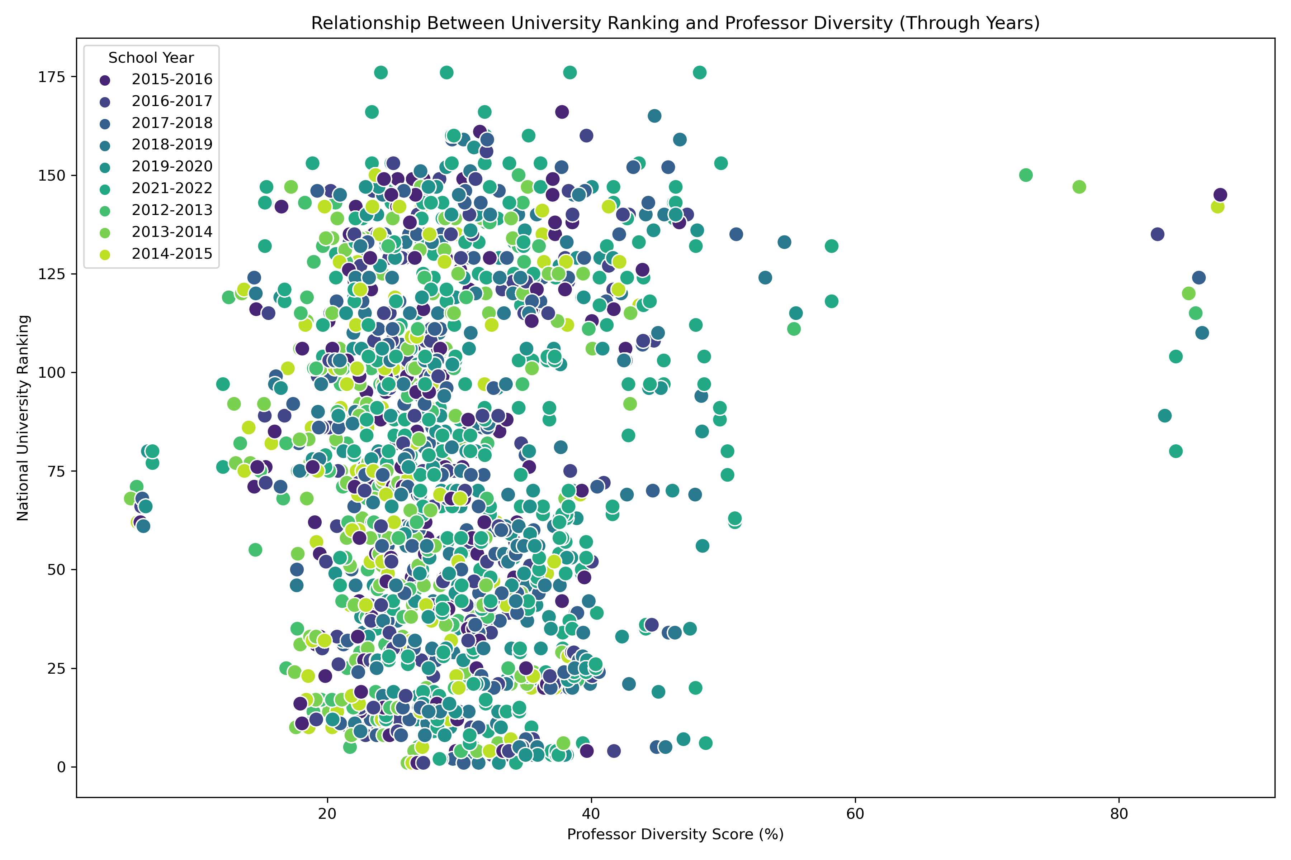
Descriptive Statistics and Data Exploration
Relationship Between University Ranking and Professor Diversity (Through Years)

Slide 17
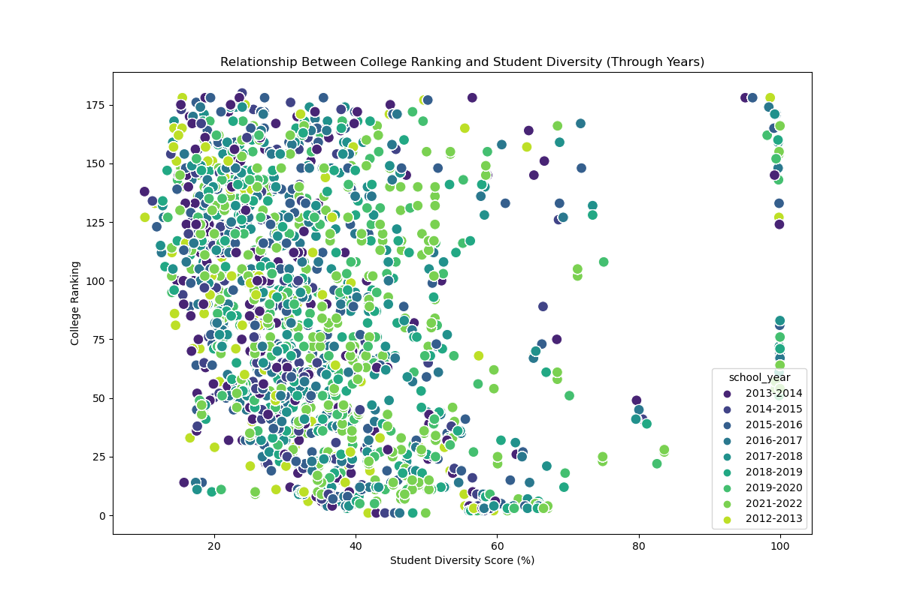
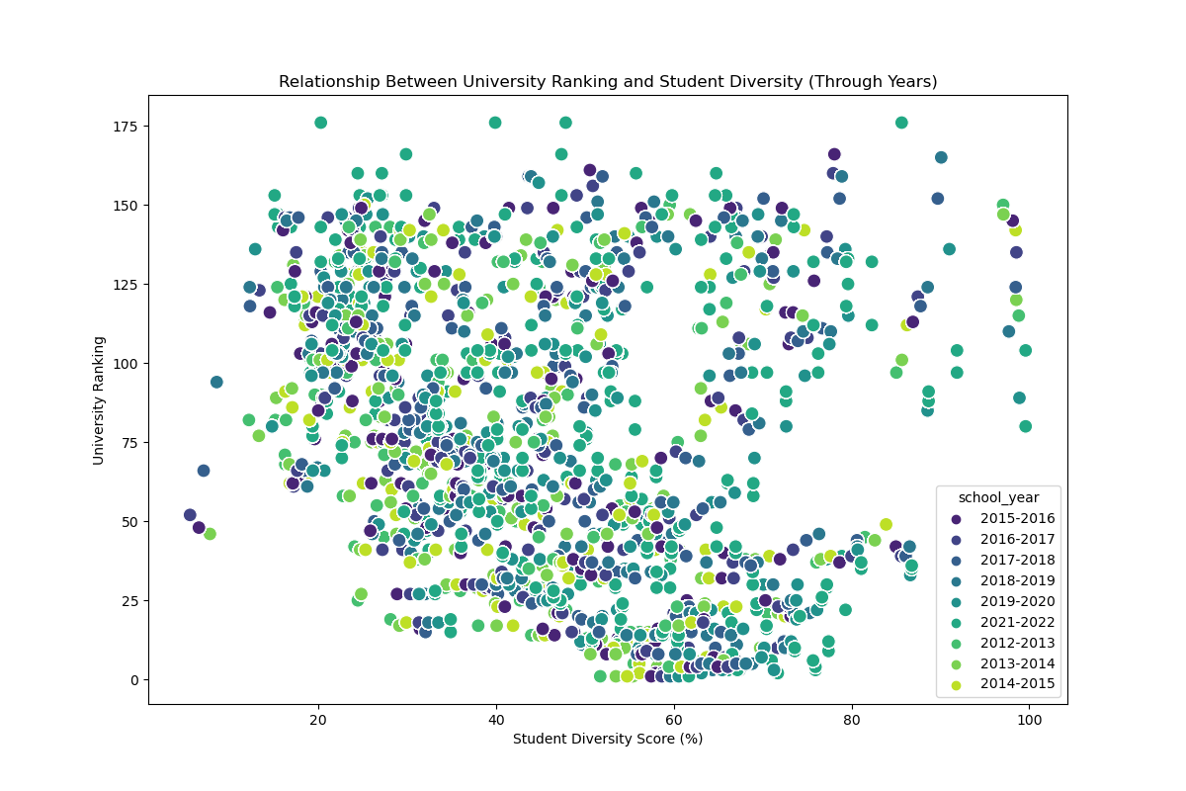
Descriptive Statistics and Data Exploration
Relationship Between University Ranking and Student Diversity (Through Years)

Slide 18
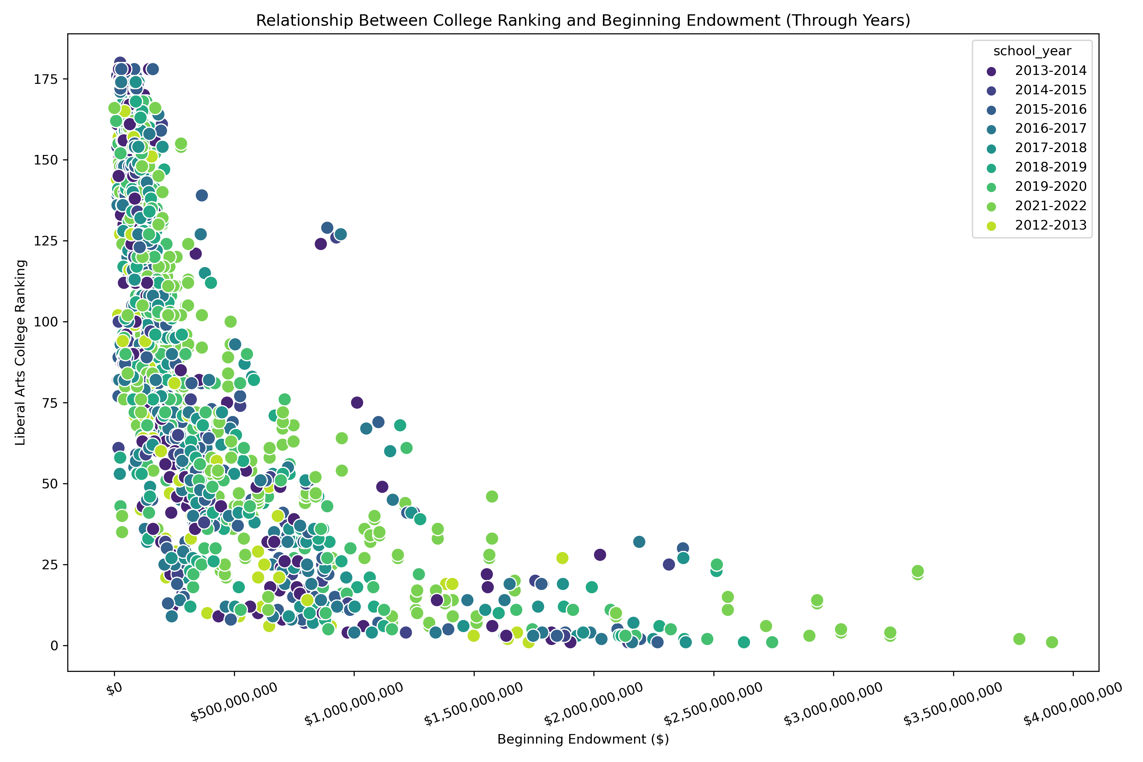
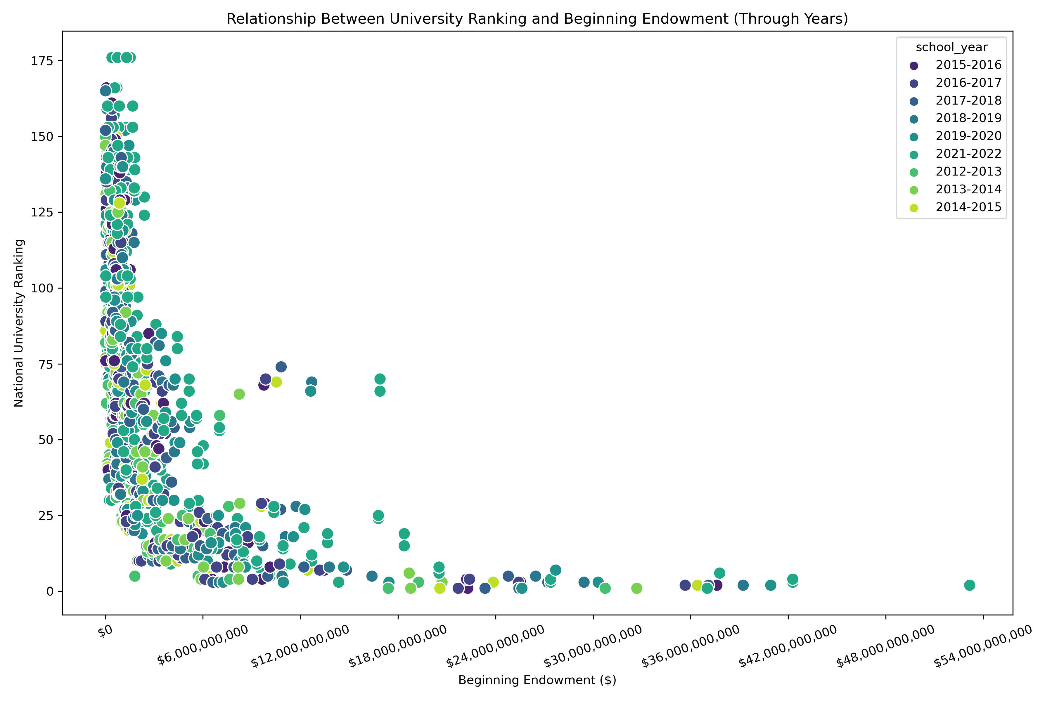
Descriptive Statistics and Data Exploration
Relationship Between University Ranking and Beginning Endowment (Through Years)

Slide 19
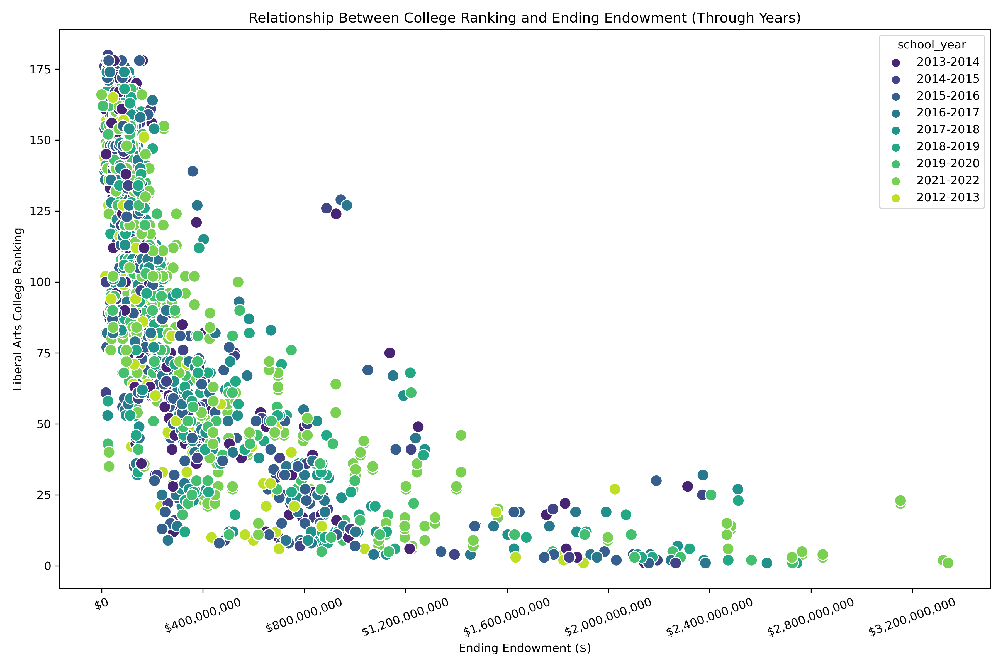
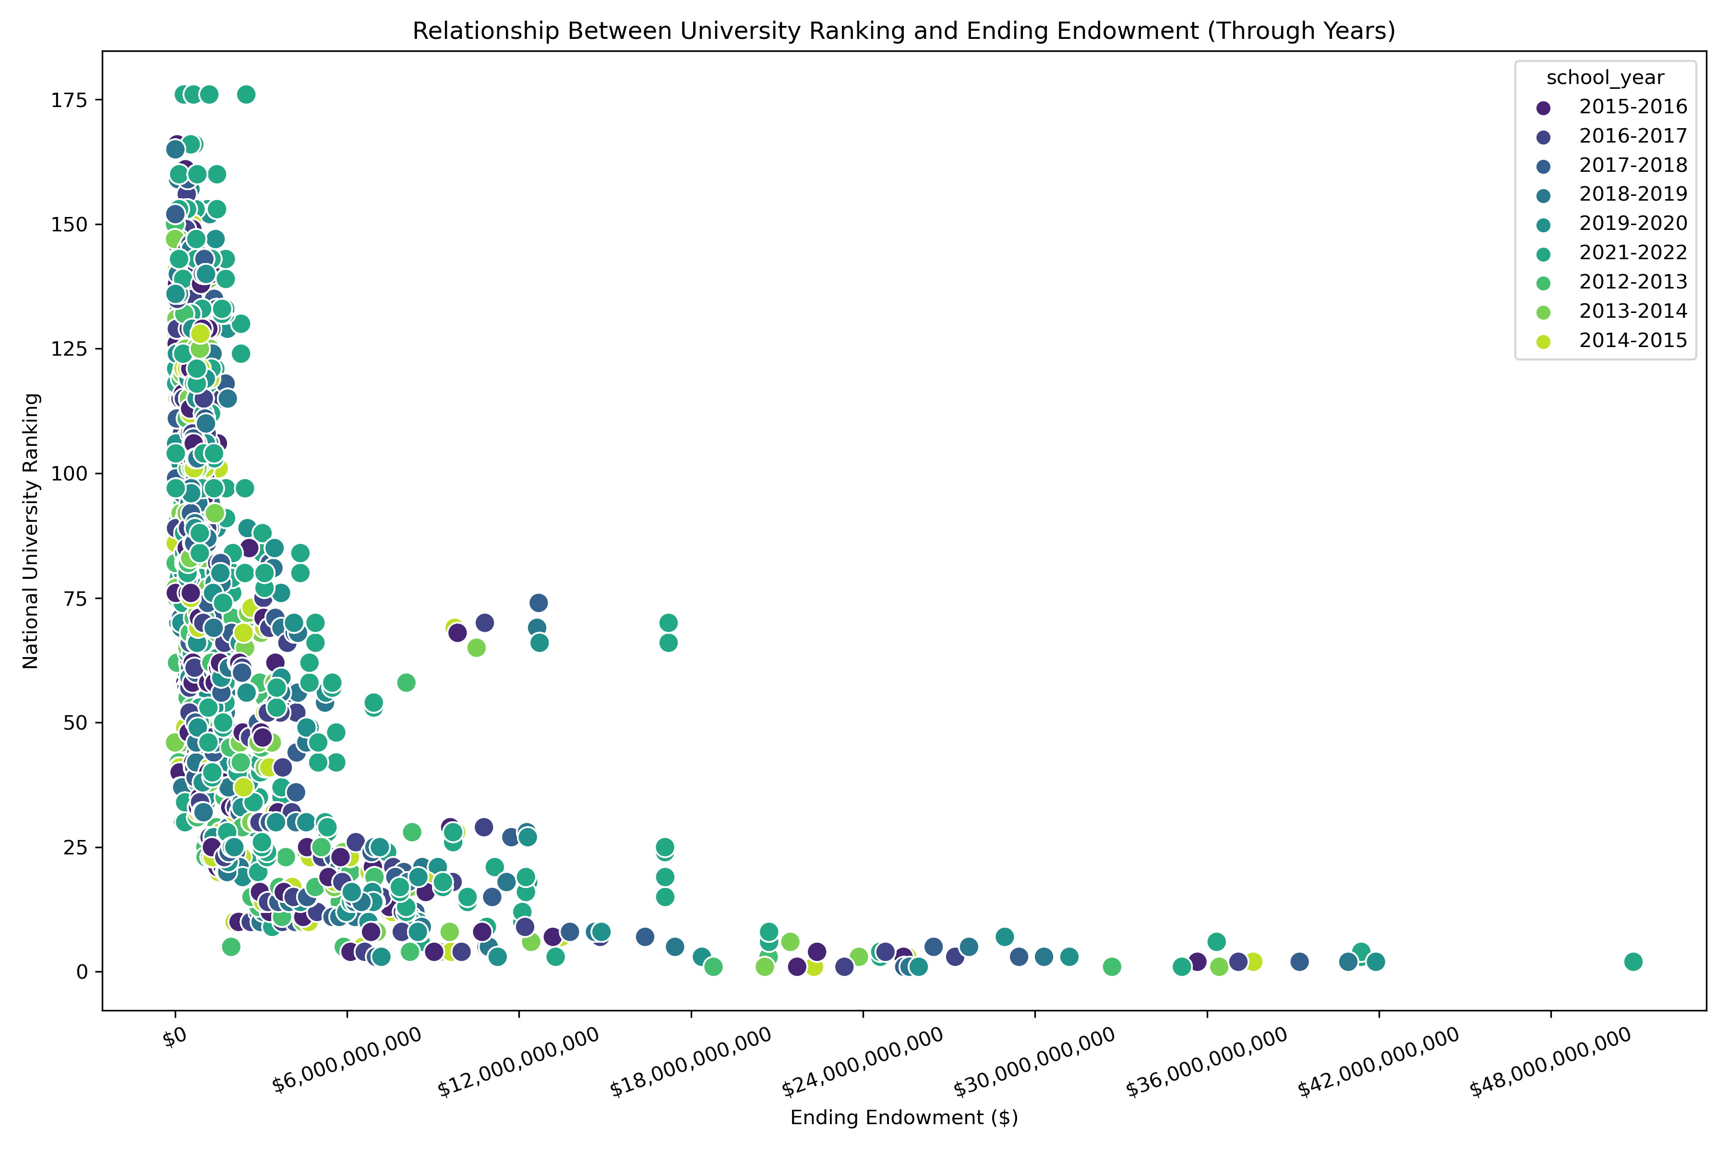
Descriptive Statistics and Data Exploration
Relationship Between University Ranking and Ending Endowment (Through Years)

Slide 20
Thank you very much!

